Slide 1
Software Architecture Design
By
Dr. Junaid Akram
Assistant Professor, Department Of Computer Science Comsats (Lahore)

Slide 2
Software Architecture
The software architecture of a program or computing system is the structure of the system, which comprise software components, the externally visible properties of those components, and the relationships among them.
Architectural Design
process for identifying the subsystems that make up a system
defines framework for sub-system control and communication

Slide 3
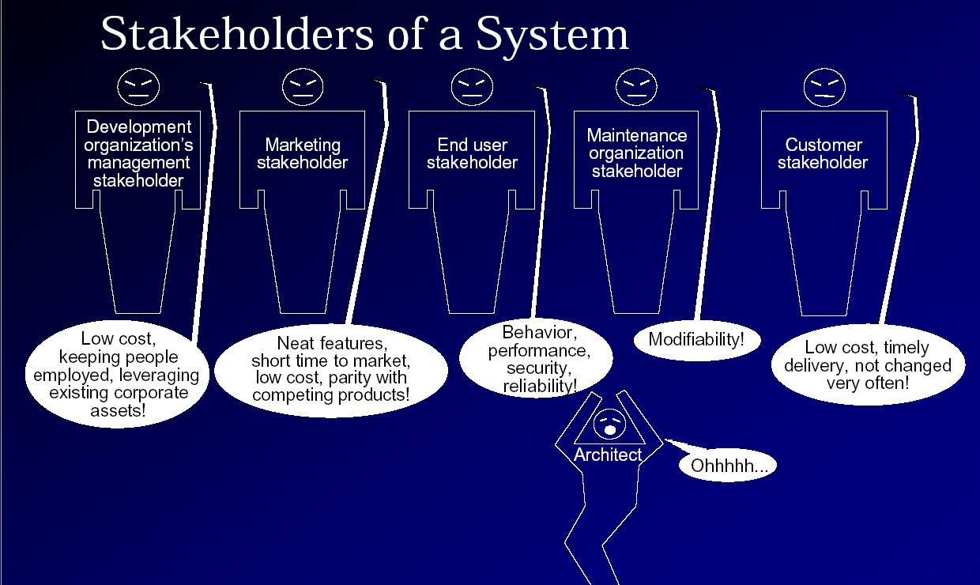
Who influences SA?

Slide 4
Why is architecture important?
Handling complexity
Communication among stakeholders
Early Design Decisions
SA is a transferable, reusable model

Slide 5
Architectural Design Process
System structuring
system decomposed into several subsystems
Control modeling
model of control relationships among system components is established
Modular decomposition
identified subsystems decomposed into modules

Slide 6
Architectural Models
Static structural model
shows major system components
Dynamic process model
shows process structure of the system
Interface model
defines subsystem interfaces
Relationships model
data flow or control flow diagrams

Slide 7
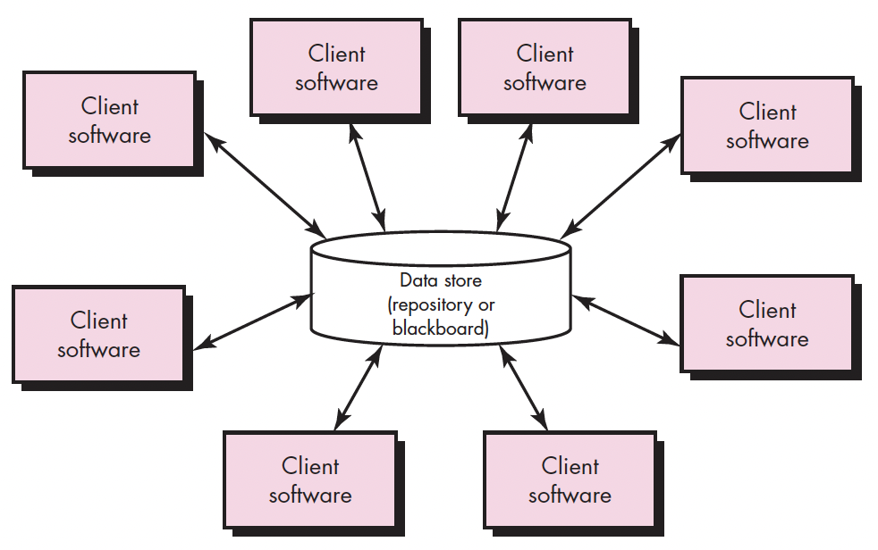
Architectural Styles
Data-centered architectures

Slide 8
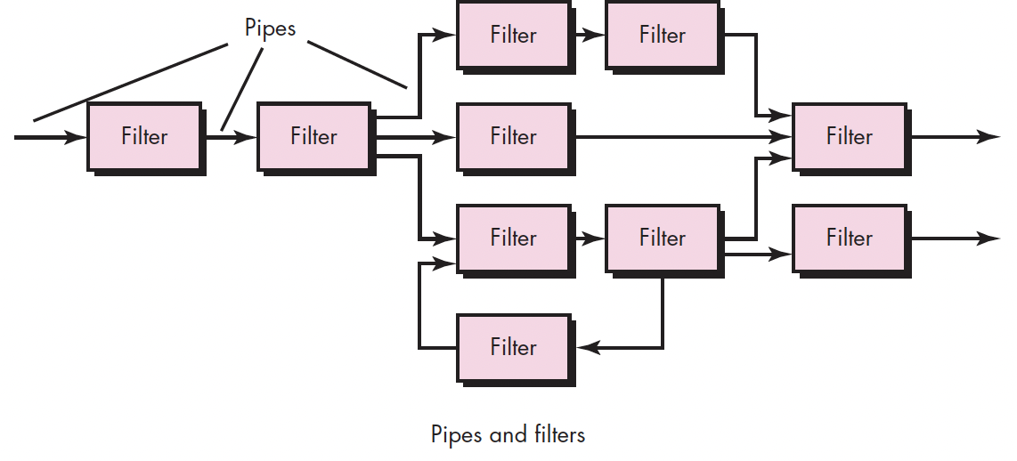
Architectural Styles
Data-flow architectures

Slide 9
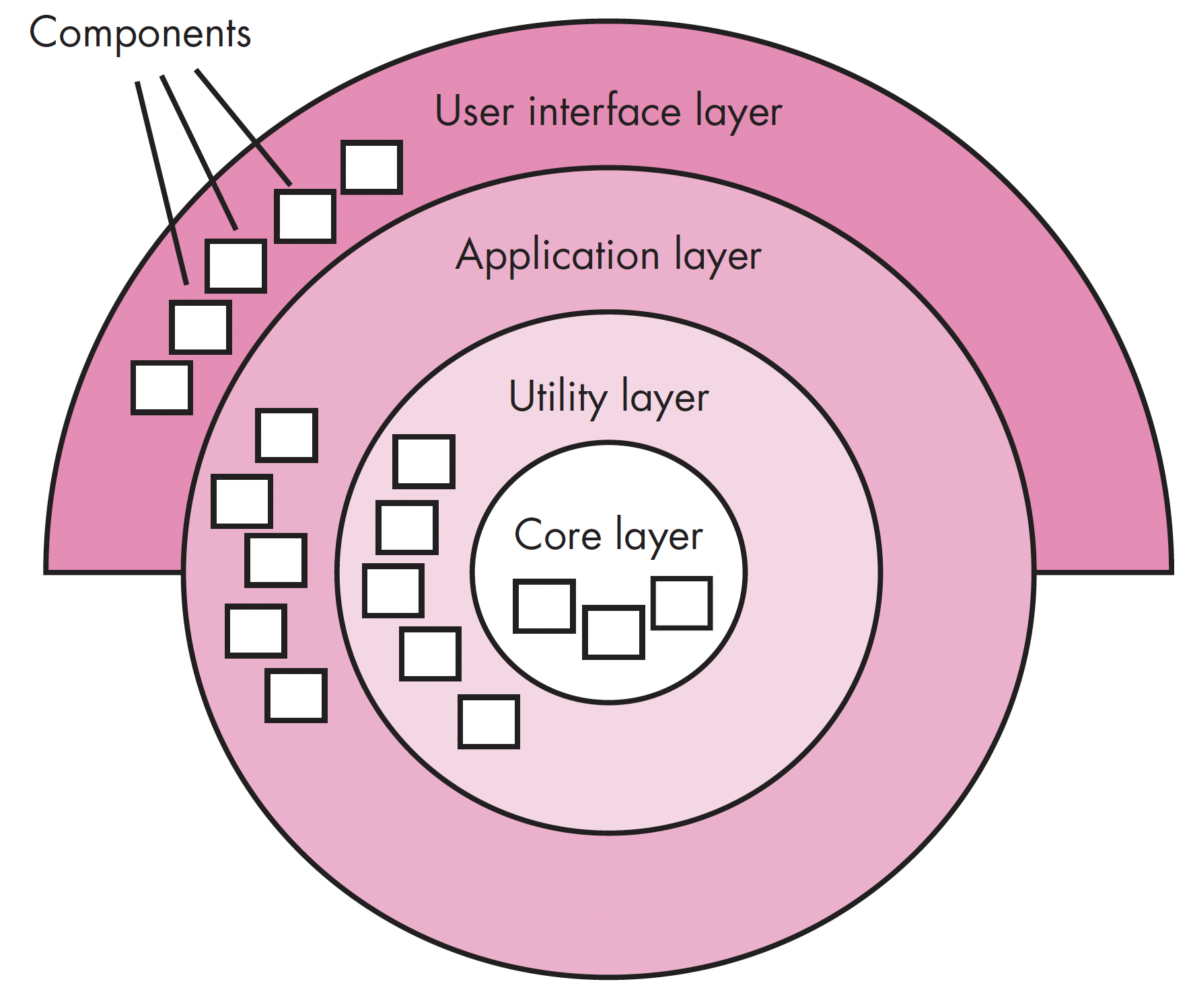
Architectural Styles
Layered architecture

Slide 10
2 Tired or Client-server architecture

Slide 11
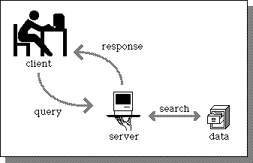
2 Tired - Client-server architecture
Distributed system model which shows how data and processing is distributed across a range of components
Set of stand-alone servers which provide specific services such as printing, data management, etc.
Set of clients which call on these services
Network which allows clients to access servers

Slide 12
Film and picture library

Slide 13
Client/Server System

Slide 14
Representative Client/Server Systems Part 1
File servers
client requests selected records from a file
server transmits records to client over the network
Database servers
client sends SQL requests to server
server processes the request
server returns the results to the client over the network

Slide 15
Representative Client/Server Systems part 2
Transaction servers
client sends requests that invokes remote procedures on the server side
server executes procedures invoked and returns the results to the client
Groupware servers
server provides set of applications that enable communication among clients using text, images, bulletin boards, video, etc.

Slide 16
Control models
Are concerned with the control flow between sub systems. Distinct from the system decomposition model
Centralised control
One sub-system has overall responsibility for control and starts and stops other sub-systems
Event-based control
Each sub-system can respond to externally generated events from other sub-systems or the system’s environment

Slide 17
A client-server ATM system

Slide 18
Computers in a C/S network

Slide 19
Layered Application Architecture

Slide 20
Application layers

Slide 21
Layered application architecture
Presentation layer
Concerned with presenting the results of a computation to system users and with collecting user inputs
Application processing layer
Concerned with providing application specific functionality e.g., in a banking system, banking functions such as open account, close account, etc.
Data management layer
Concerned with managing the system databases

Slide 22
ISO/OSI network model
Application

Slide 23
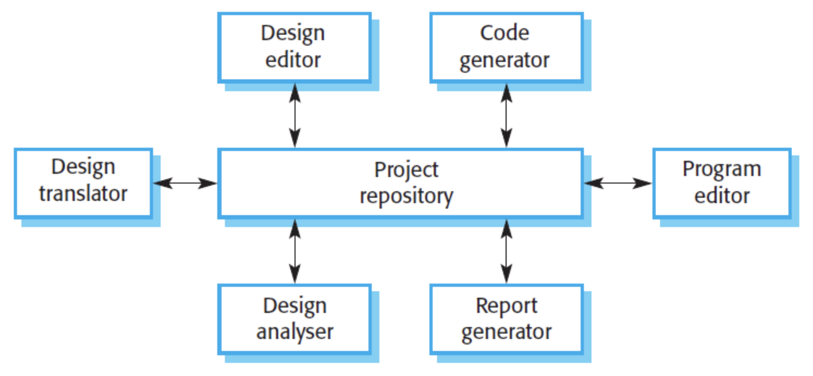
Repository Model
A repository model is a system that allow interfacing sub-systems to share the same data. Sub-system must exchange data so that they can work together effectively.

Slide 24
Repository Model
Advantages:
It is an efficient way to share large amounts of data. There is no need to transmit data explicitly from one sub-system to another.
Sub-systems that produce data need not be concerned with how that data is used by other subsystems.
Activities such as backup, security, access control and recovery from error are centralized.
Disadvantages:
It requires some specific tools. Performance may be adversely affected by this compromise.
Evolution may be difficult as a large volume of information is generated according to an agreed data model.
Different sub-systems may have different requirements for security, recovery and backup policies.
The repository model forces the same policy on all subsystems.

Slide 25
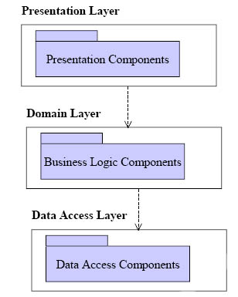
Three-tier Architecture
Each application architecture layers (presentation, application, database) may run on separate processors
Allows for better performance
Simpler to manage
Highly scalable (as demands increase add more servers)

Slide 26
Three-Tier Architecture- Example

Slide 27
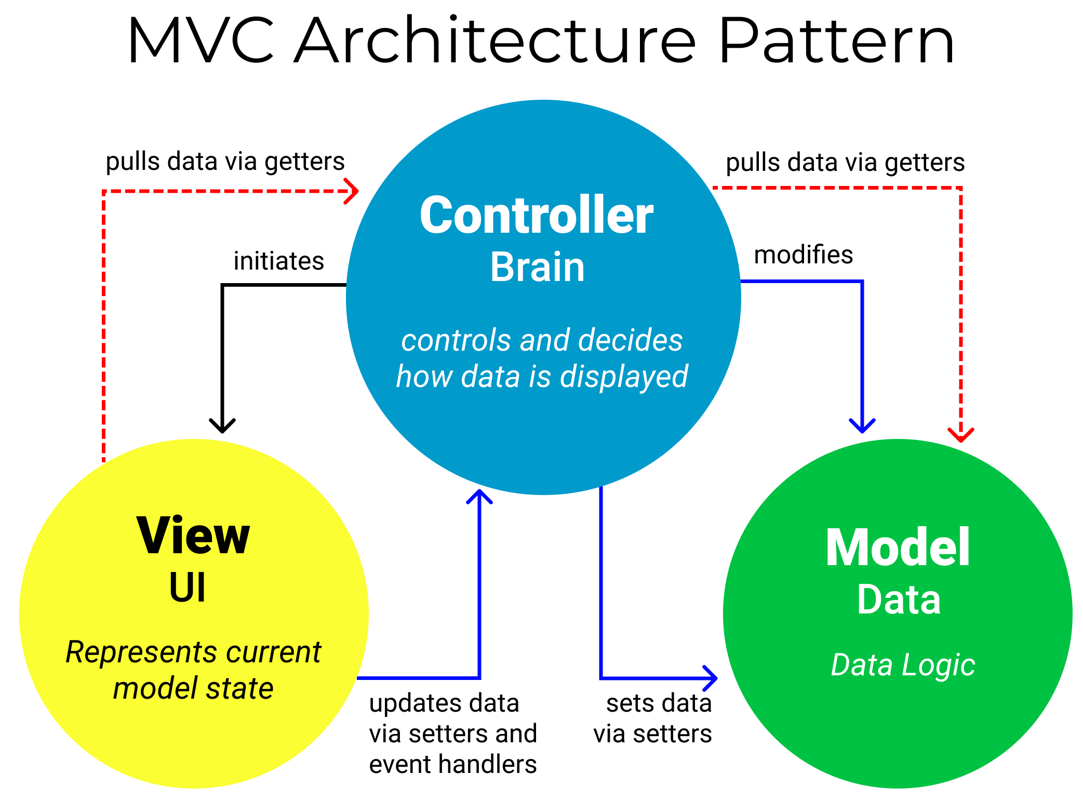
Model-View-Controller (MVC)
It is an architectural pattern that separates an application into three main logical components: the model, the view, and the controller.
MVC is one of the most frequently used industry-standard web development framework to create scalable and extensible projects.

Slide 28
Model
The Model component corresponds to all the data-related logic that the user works with. This can represent either the data that is being transferred between the View and Controller components or any other business logic-related data.
View
The View component is used for all the UI logic of the application. For example, the Customer view will include all the UI components such as text boxes, dropdowns, etc. that the final user interacts with.
Controller
Controllers act as an interface between Model and View components to process all the business logic and incoming requests, manipulate data using the Model component and interact with the Views to render the final output.

Slide 29
Model-View-Controller as Three-Layered Pattern
Context
Provides a flexible structure for developing interactive applications.
Problem
User interfaces are subject to changes. As new features are added to the system, the UI must provide appropriate command and menus to handle them.
Different platforms support different ‘look and feel’ standards; the UI must be portable.
Different kind of users may expect different data format from the UI (bar char, spreadsheet etc.).
Solution
Divide the system into three parts: processing, output, and input:
Model: contains the processing and the data involved.
View: presents the output; each view provides specific presentation of the same model.
Controller: captures user input (events-> mouse clicks, keyboard input etc.). Each view is associated to a controller, which captures user input.

Slide 30
Several Other
Architectural Models

Slide 31
Real-Time System Control Model

Slide 32
Selective Broadcasting Model

Slide 33
Compiler Model

Slide 34
Multiprocessor Traffic Control System from Sommerville

Slide 35

Thanks for your attention!
Any Question?
Email me on : junaid.akram@xmu.edu.my

